Slide 1

Exploratory Data Analysis and Visualization of bus fares data using R techniques
DSA0613-Data handling and visualization for Data Analytics
  Supervisor
  Dr.Kumaragurubaran
  Dr.Senthilvadivu Subramanian
  Dept.of CSE
  Saveetha School of Engineering
Presented By
N.Kishan Kumar(192424404)
S.Tushar Krishna Sai(192424406)
G.Vinay Kumar Reddy(192424245)

Slide 2
INTRODUCTION TO THE RESEARCH DOMAIN
Exploratory Data Analysis (EDA) helps in understanding data characteristics before further analysis.
Data visualization makes complex data easier to interpret and analyze.
Graphs and plots help identify trends, patterns, and anomalies in datasets.
Advanced plotting tools in R provide powerful support for effective data visualization.

Slide 3
RESEARCH OBJECTIVES
To enhance data understanding using advanced visualization techniques in R.
To analyze temporal and frequency-based data using effective plots.
To explore relationships among multiple variables through graphical analysis.
To support better data-driven decision-making using visual insights.

Slide 4
PROBLEM DEFINITION
Exploratory Data Analysis (EDA) is essential for understanding the structure and behaviour of data before further analysis.
Advanced plotting techniques in R help visualize data more clearly and effectively.
Visualizations assist in identifying trends, patterns, relationships, and anomalies in datasets.
R plotting libraries enable better interpretation of complex and large datasets.

Slide 5
LITERATURE REVIEW OVERVIEW
Existing studies mainly focus on basic Exploratory Data Analysis techniques.
Traditional visualizations provide limited insights for complex datasets.
R offers advanced plotting libraries that support effective data exploration.
Limited research combines uncertainty handling and multivariate visualization using R.

Slide 6
PROPOSED SYSTEM / FRAMEWORK ARCHITECTURE
The system uses R to perform advanced exploratory data analysis on datasets.
Data is first collected and preprocessed to ensure accuracy and consistency.
Transformed data is visualized using advanced R plotting libraries.
Multiple plots are generated to analyze trends, distributions, uncertainty, and relationships.
Visual outputs help users gain insights and support effective decision-making.

Slide 7
START
⬇️⬇️⬇️
LOAD DATASET
⬇️⬇️⬇️
Data Preprocessing
⬇️⬇️⬇️
Perform Exploratory Data Analysis
⬇️⬇️⬇️
MODULE 1:- Temporal, Frequency, and Uncertainty Visualization
⬇️⬇️⬇️
Module 2:Multivariate Relationship &DistributionAnalysis
⬇️⬇️⬇️
Module 3:Data Transformation, Outlier Detection, and Summary Visualization
⬇️⬇️⬇️
Generate Visual Insights
⬇️⬇️⬇️
END

Slide 8
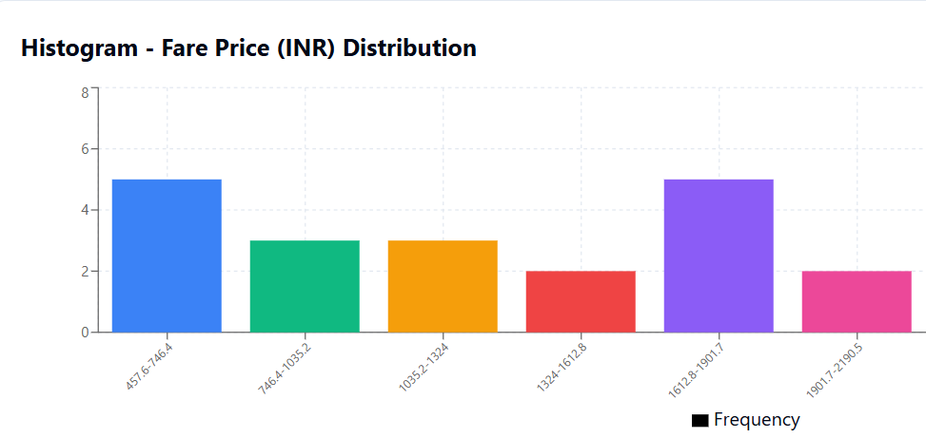
MODULE 1:- Temporal, Frequency, And Uncertainty Visualization
Analyzes how data changes over time using line plots.
Identifies most frequent values using bar charts.
Studies variation and uncertainty in data using histograms.
Helps understand overall trends and patterns in the dataset

Slide 9
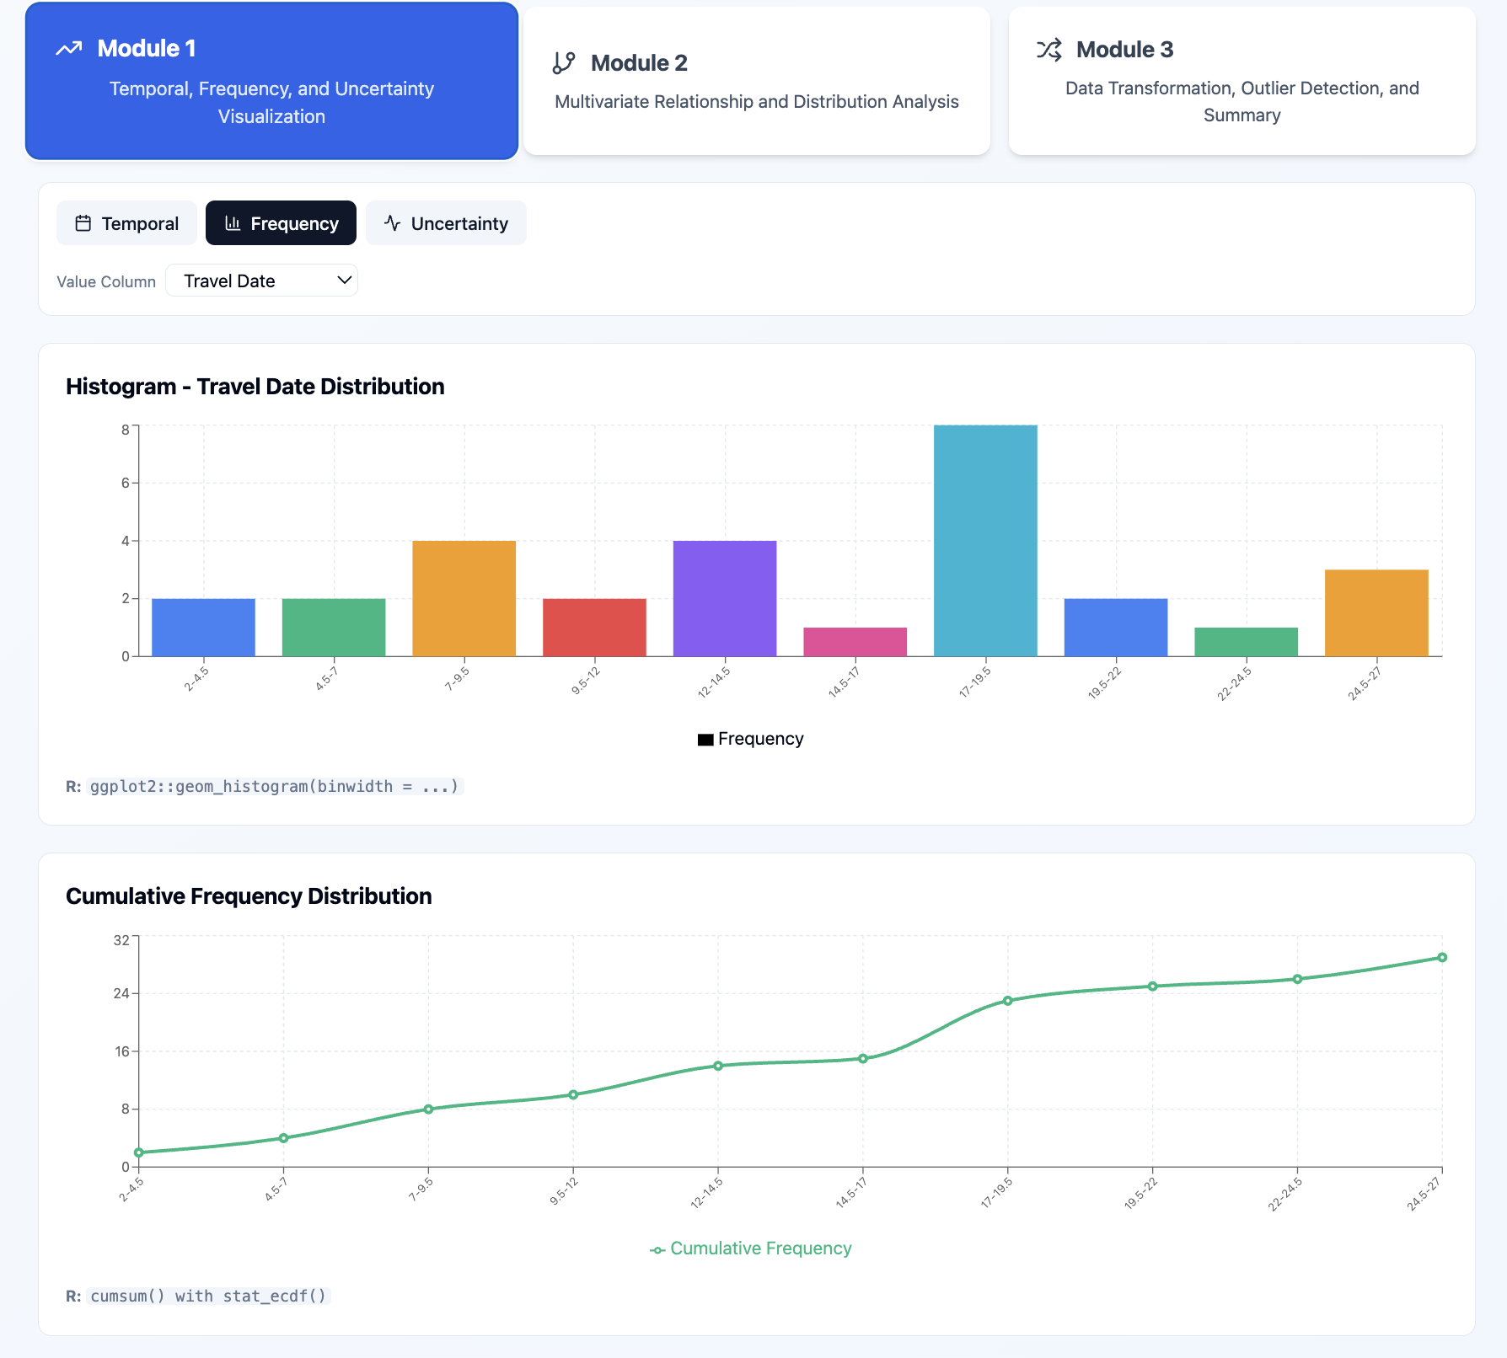

Slide 10
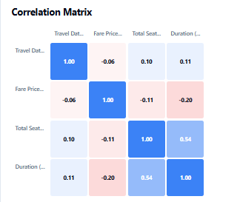
Module 2: Multivariate Relationship And Distribution Analysis
Exploratory Data Analysis (EDA) helps in understanding patterns, trends, and structure of Indian bus fare data using visual methods.
Scatter plots are used to examine relationships between fare, travel distance, and journey duration, helping identify positive or negative trends.
Box plots compare fare distributions across different categories and highlight median values, spread, and outliers.
A correlation matrix identifies the strength and direction of relationships among numerical variables influencing bus fare.
These visual insights support efficient query processing, better pricing decisions, and improved transportation planning.

Slide 11
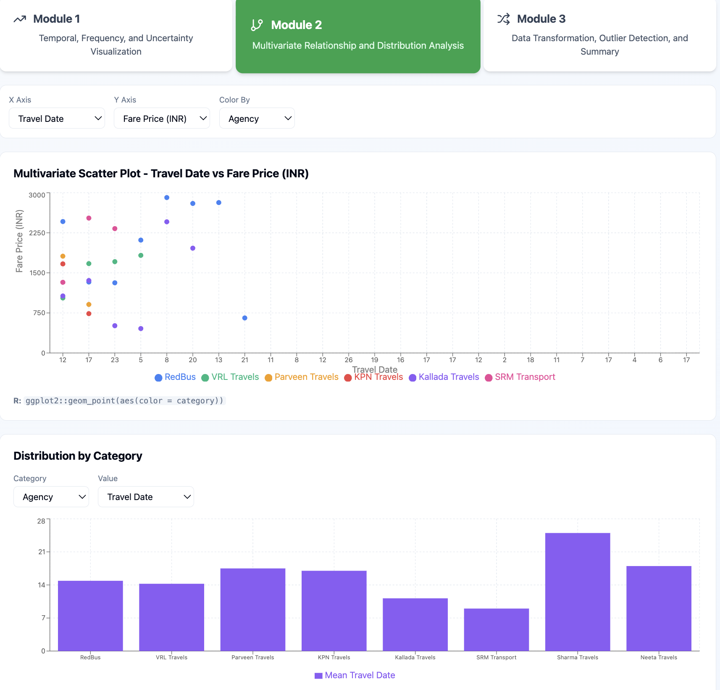

Slide 12
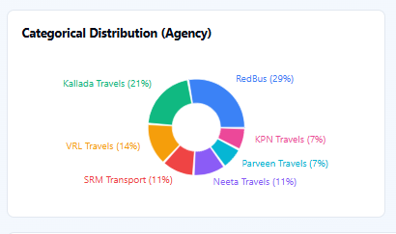
Module 3: Data Transformation, Outlier Detection, and Summary Visualization
Transforms raw data into a clean and usable format using scaling and normalization.
Detects unusual or extreme values in the dataset using outlier detection methods.
Summarizes data using visual tools like box plots and summary charts.
Helps in understanding the overall distribution, spread, and key characteristics of the data.

Slide 13
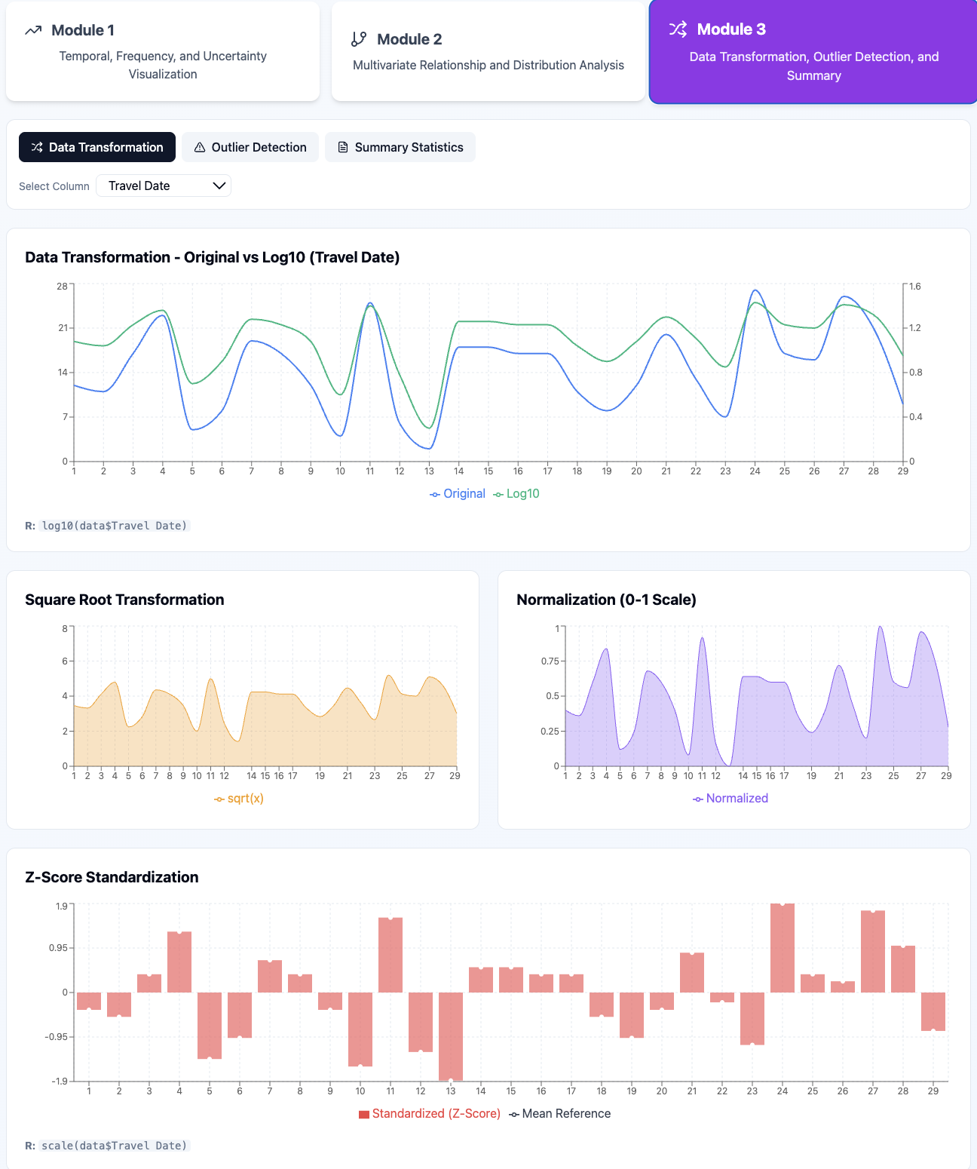

Slide 14
CONCLUSION
Exploratory Data Analysis helps in understanding data clearly before processing queries.
Advanced visualizations make trends, patterns, and variations easy to identify.
Multivariate analysis improves insight by showing relationships between variables.
Pandas and Matplotlib together provide an effective solution for data analysis.

Slide 15
REFERENCES
McKinney, W. (2010). Data structures for statistical computing in Python. Proceedings of the 9th Python in Science Conference, 51–56.
Hunter, J. D. (2007). Matplotlib: A 2D graphics environment. Computing in Science & Engineering, 9(3), 90–95. https://doi.org/10.1109/MCSE.2007.55
Tukey, J. W. (1977). Exploratory data analysis. Addison-Wesley.
VanderPlas, J. (2016). Python data science handbook: Essential tools for working with data. O’Reilly Media.
Pandas Development Team. (2023). pandas documentation. https://pandas.pydata.org/docs/

Slide 16
THANK YOU!

